Slide 1
ACE 592 Final Presentation
By: Ziad Alian, Massab Qayum, Michael Kurtenbach, Jessica Gu,

Slide 2
Agenda
Research Topic | 3
Data Source | 4
Extracting/Cleaning the Data | 7
General Analysis | 10
Lasso Regression | 16
Final Results | 27

Slide 3
Research TopicTopic
In the Biopharma industry, drugs that do not have a patent are very susceptible to people easily changing off them for a better alternative
We know a lot about drugs from the company perspective, but how do consumers feel about the drugs?
We took 6 different drugs for type II Diabetes, and ran an analysis to gain information on
What is the sentiment of each drug?
What are the common words mentioned for each drug?
What is the LASSO regression for various y’s (ratings, sentiment, term frequency)
Notes:
Sentiment on text, rating column, and then term frequency

Slide 4
Data Source
We needed Data on the following things:
Multiple reviews for multiple different type II diabetes drugs
Preferably >100+ for each drug for some level of statistical significance
Review Scores to use as a dependent variable to predict what words lead to high review scores
Looked into multiple sources
Webmd
Drugbank
RxList

Slide 5
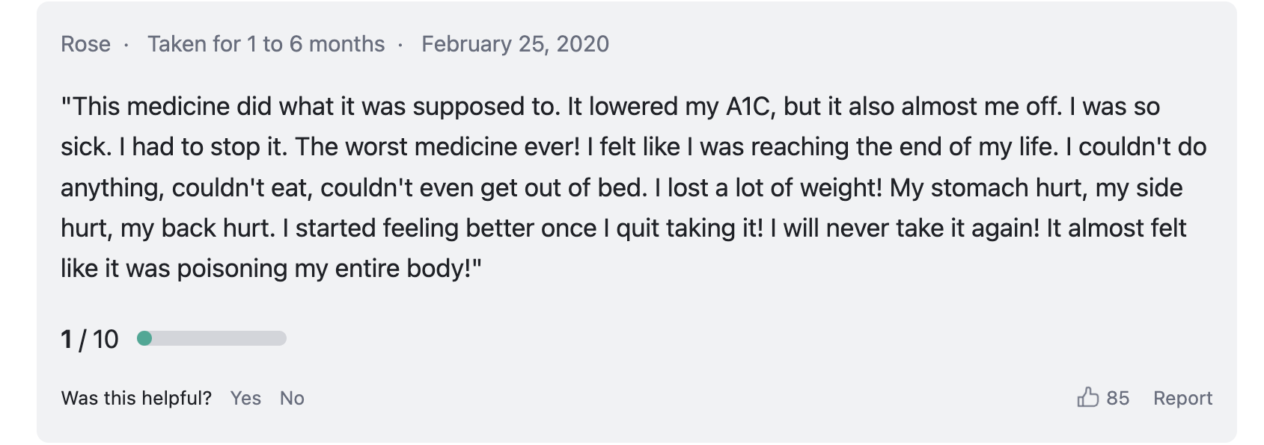
Chosen Data Source
Drugs.com

Slide 6
Important Information
We were only able to get the first 5 pages of drug reviews for each drug
Pages 6+ required sign on in order to access
The 6 drugs we reviewed were:
Victoza
Sitagliptin
Rybelsus
Ozempic
Mounjaro
Jardiance

Slide 7
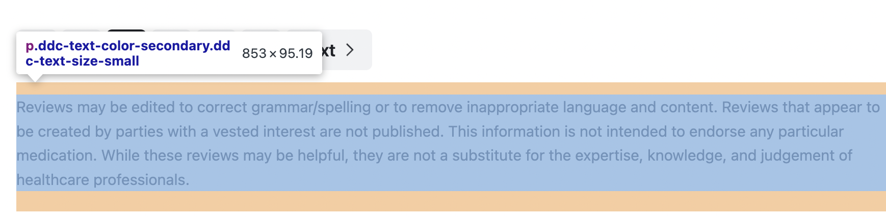
First Time Extracting Data
Originally I used beautifulsoup find all ’p’ to locate all the paragraphs and manually went through each page of text to cut all the extract unnecessary information

Slide 8
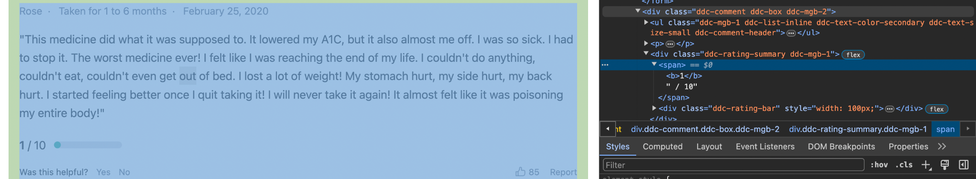
Round Two:
However, we decided we needed the user ratings as well in order to a better understanding of the consumers actual feelings towards the drugs
Found out beautiful soup can find more than just ‘p’, can also find <div class=>

Slide 9
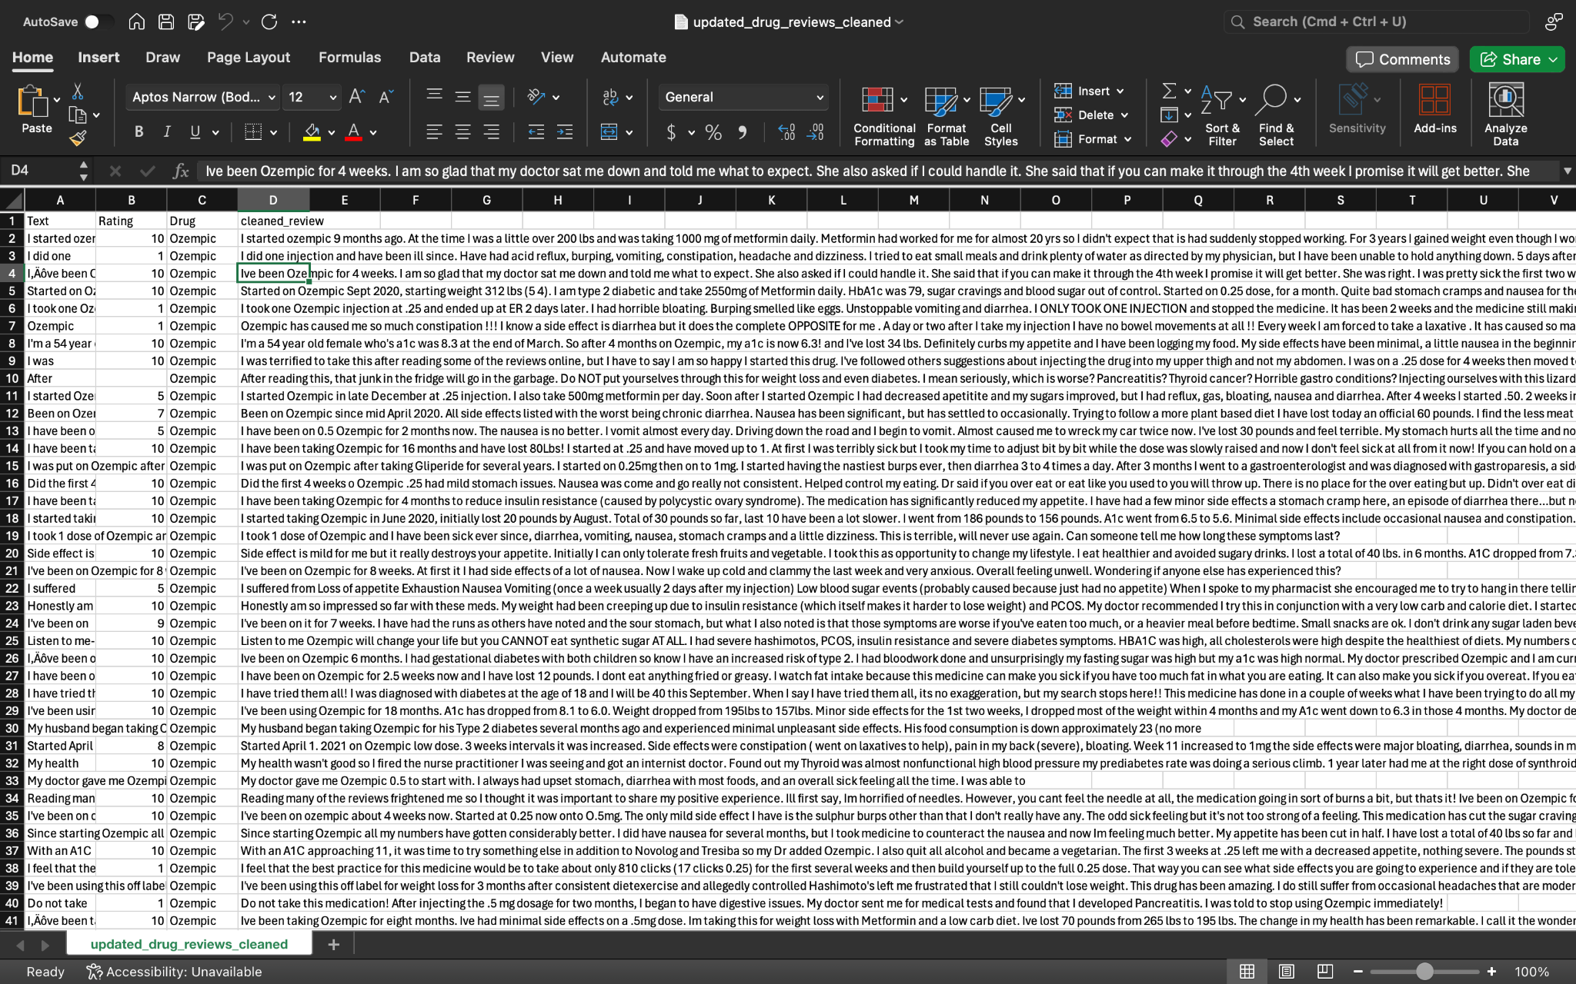
Final Data

Slide 10
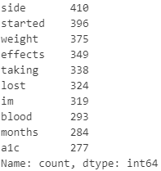
Some Text Processing
Created a sentiment score for each row (review)
Created a list of words for each row
Created a list of pairs of words for each row
Will be useful later in the Lasso regressions
To get most common words, combined all text together
Removed punctuation, set to lowercase, removed stop words
Most common words:

Slide 11
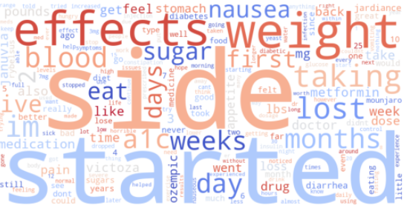
Descriptive Analysis
Word cloud for all reviews
Common words include
Side effects
Duration (e.g., how long the drug’s been used)
Symptoms

Slide 12
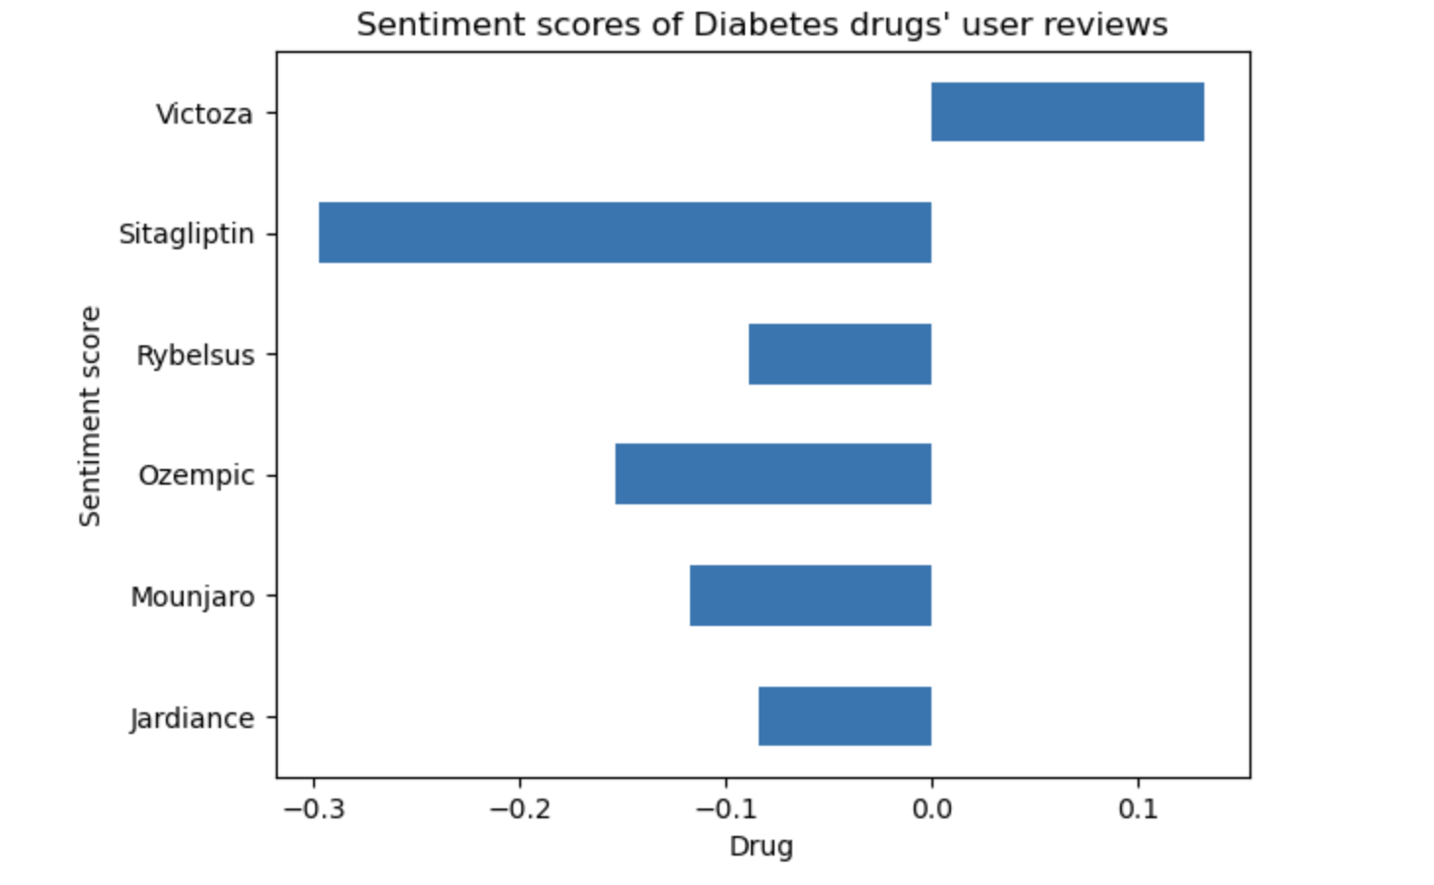
Descriptive Analysis
For each drug, we had 125 data points

Slide 13
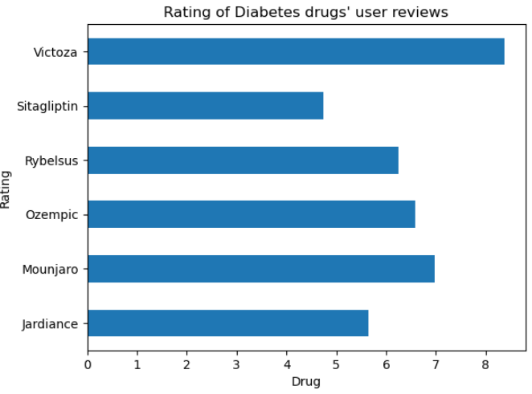
Descriptive Analysis
Similarly, Victoza had the highest average rating

Slide 14
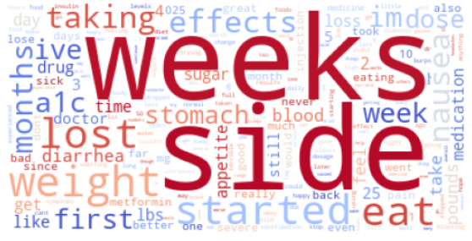
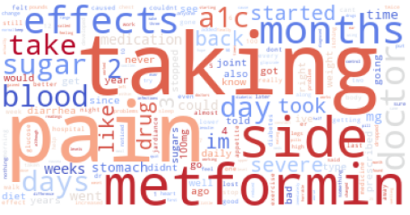
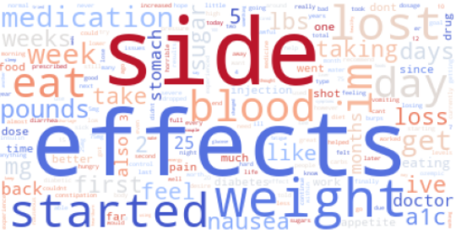
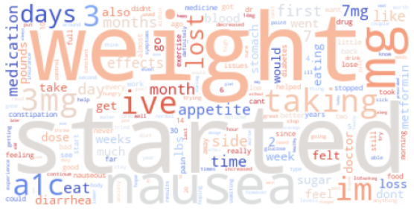
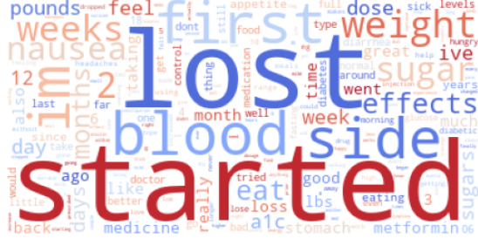
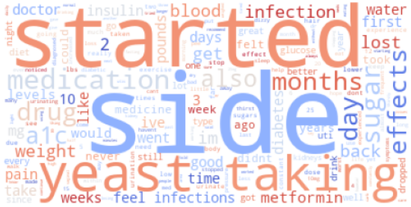
Descriptive Analysis
Word cloud per drug
1. Ozempic | 2. Sitagliptin
3. Mounjaro | 4. Rybelsus
5. Victoza | 6. Jardiance

Slide 15
Methodology
Least Absolute Shrinkage and Selection Operator (LASSO) Regression:
Variable Selection through Regularization
Minimization objective = LS Obj + α * (sum of the absolute value of coefficients)
Python’s LassoCV function with cross-validation set to 10
Dependent Variables:
Rating
Sentiment
Meaning (Term Frequency-Inverse Document Frequency)

Slide 16
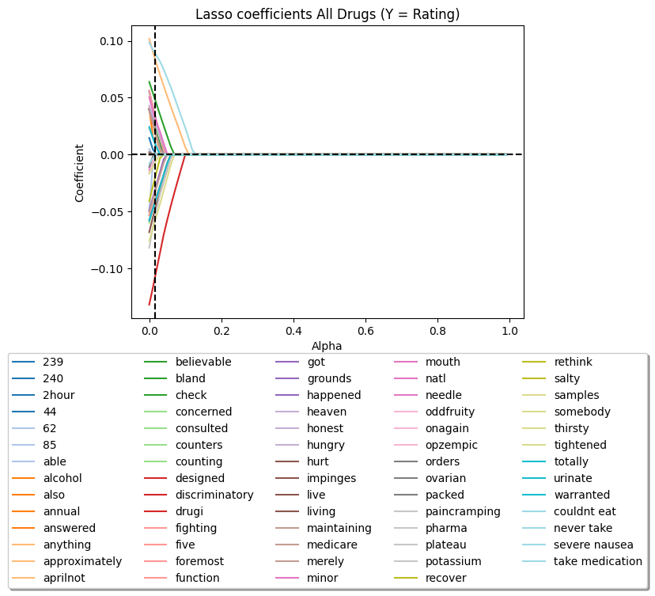
Rating

Slide 17
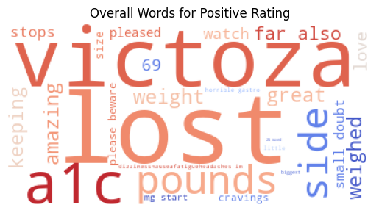
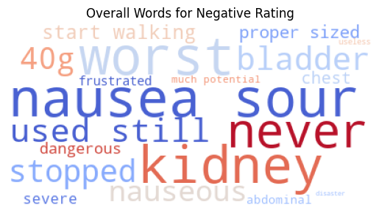

Slide 18
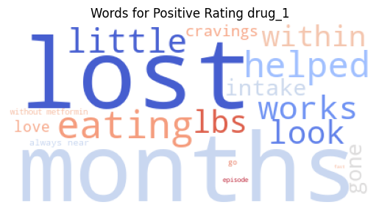
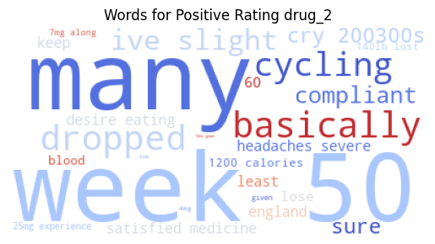
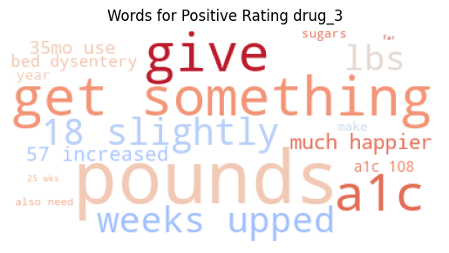
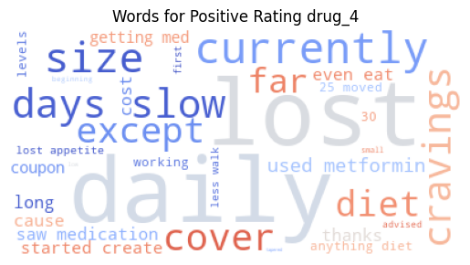
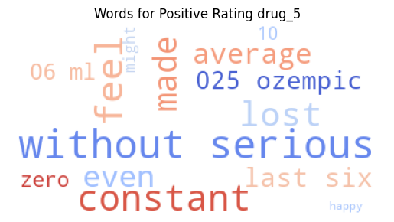
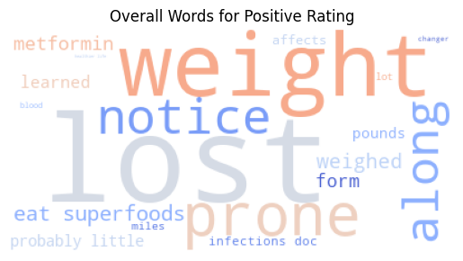
1. Ozempic | 2. Sitagliptin
3. Mounjaro | 4. Rybelsus
5. Victoza | 6. Jardiance

Slide 19
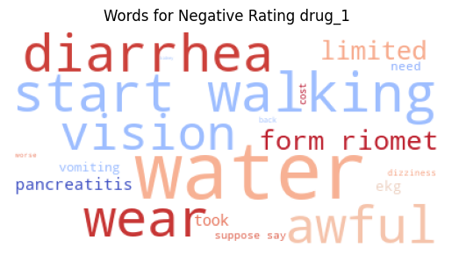
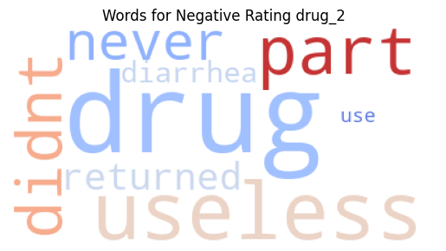
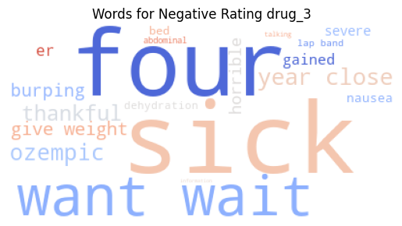
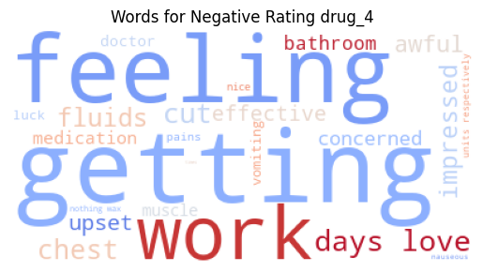
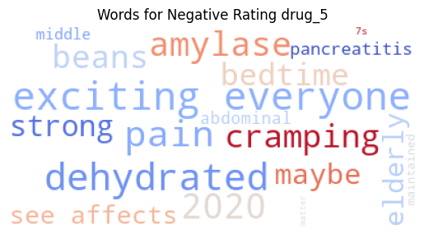
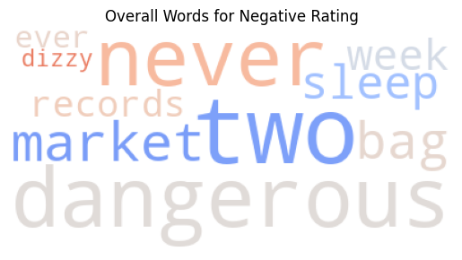
1. Ozempic | 2. Sitagliptin
3. Mounjaro | 4. Rybelsus
5. Victoza | 6. Jardiance

Slide 20
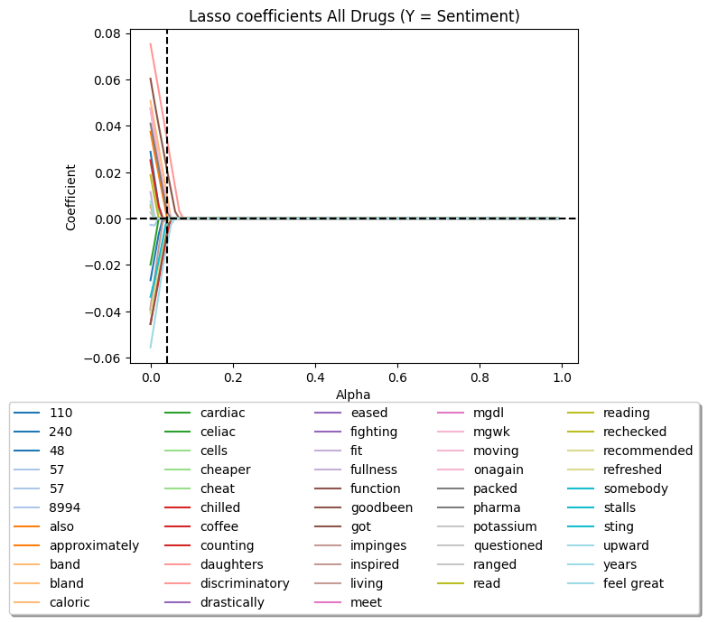
Sentiment

Slide 21
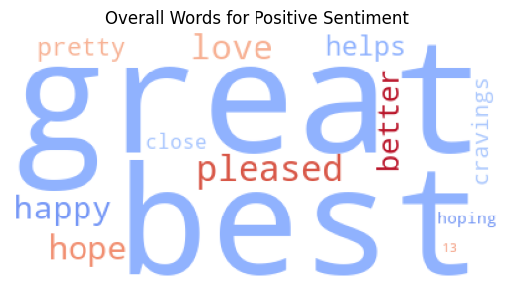
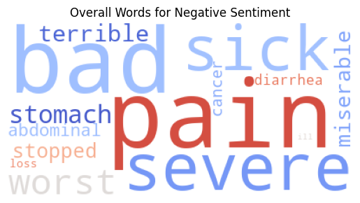

Slide 22
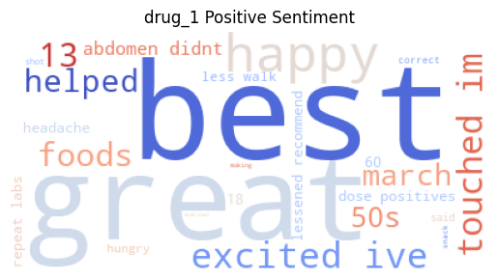
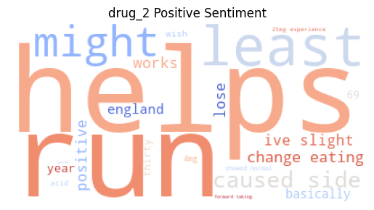
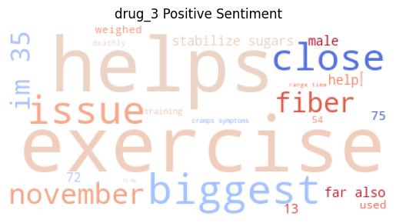
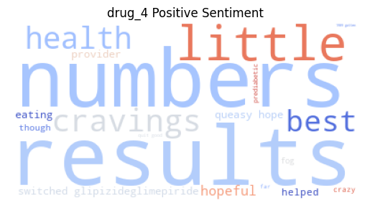
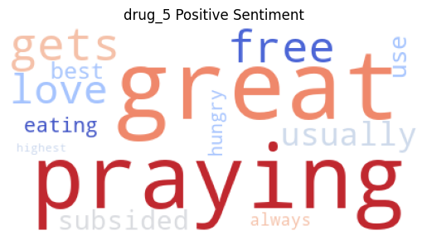
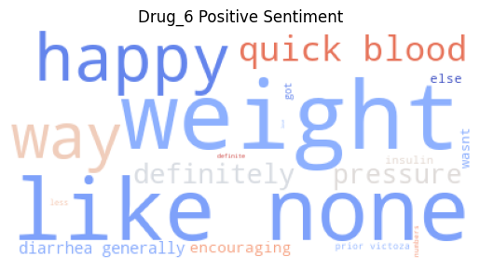
1. Ozempic | 2. Sitagliptin
3. Mounjaro | 4. Rybelsus
5. Victoza | 6. Jardiance

Slide 23
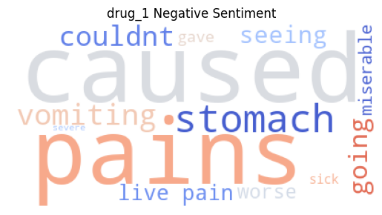
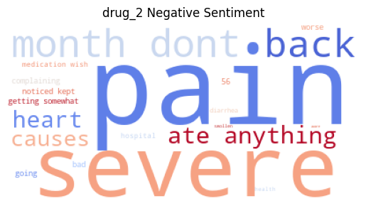
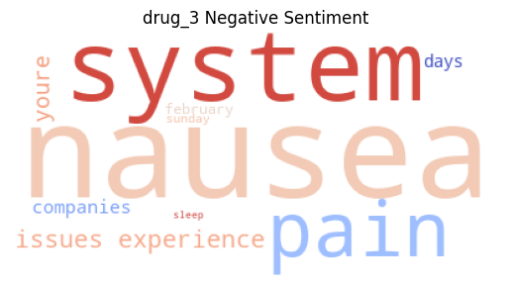
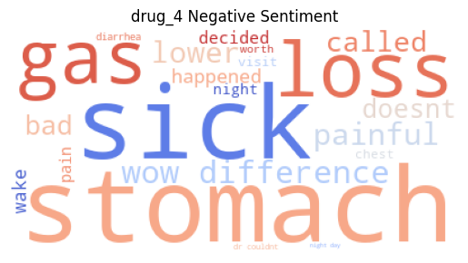
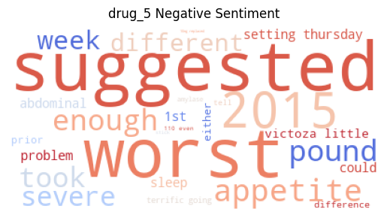
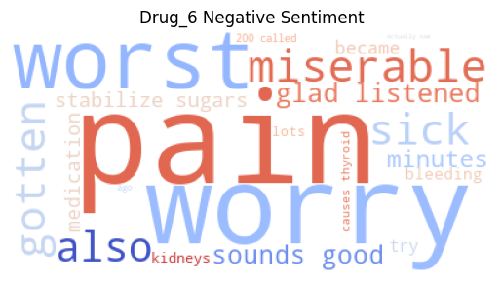
1. Ozempic | 2. Sitagliptin
3. Mounjaro | 4. Rybelsus
5. Victoza | 6. Jardiance

Slide 24
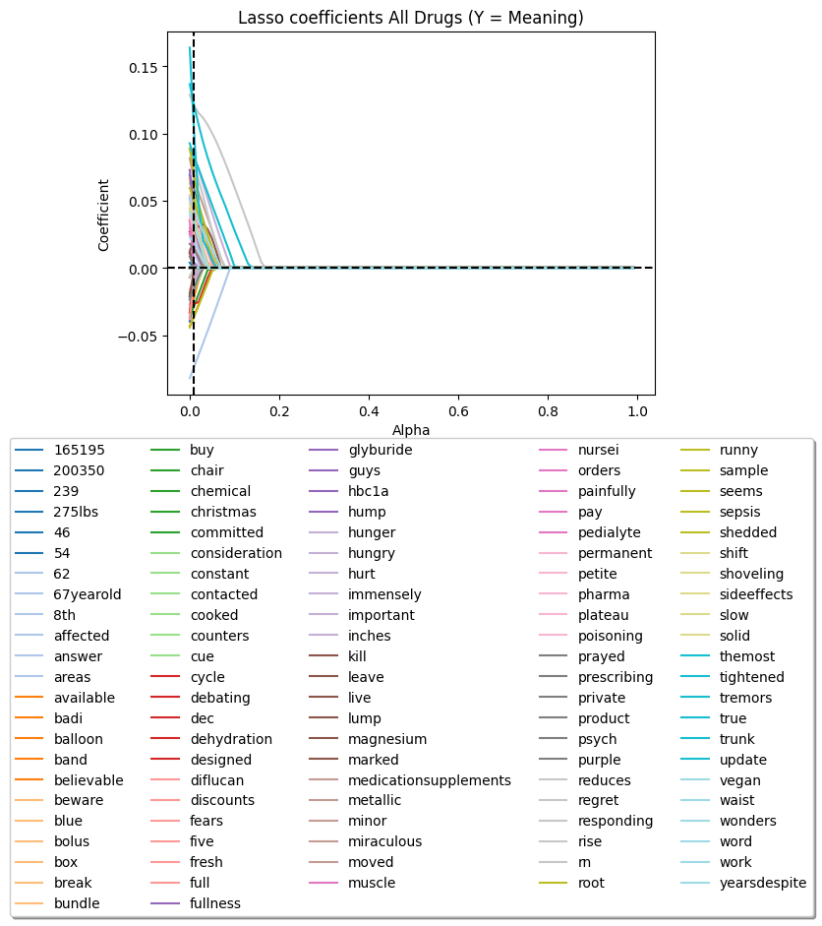
Term Frequency-Inverse Document Frequency
(Meaning)

Slide 25
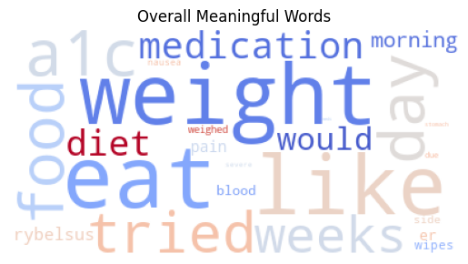
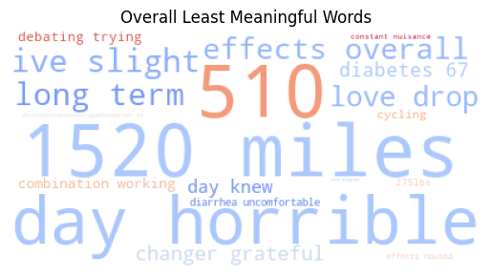

Slide 26
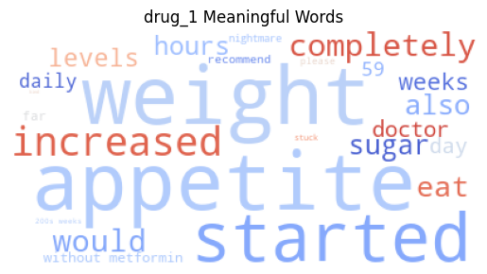
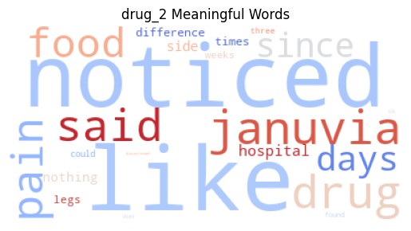
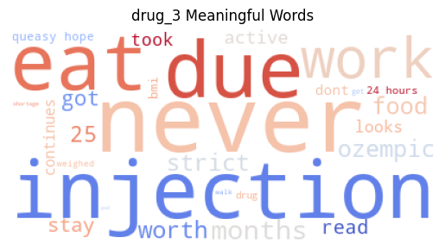



1. Ozempic | 2. Sitagliptin
3. Mounjaro | 4. Rybelsus
5. Victoza | 6. Jardiance

Slide 27






1. Ozempic | 2. Sitagliptin
3. Mounjaro | 4. Rybelsus
5. Victoza | 6. Jardiance

Slide 28
CONCLUSION
What we do in one word: REVIEW HERO
Implications:
By knowing the most meaningful words for consumers in their review, we can know what’s important to them, what’s the effect of these review on perception or ratings.
Help firms improve their drugs on post-treatment experience aspect.
Future Analysis:
More kind of drugs, more variables(pricing, timing etc,.) included.
Multiple platforms and spillover effects on other drug websites or social media
Large Language Models be combined to explore deeper and wider to predict rating.

